Slide 1

Pedagogy First
Tara Gilboa

Slide 2

Welcome! Happy Tuesday,
Outcomes:
Explain how Tara’s professional background influenced today’s topic
Describe the structure and best practices of a anticipatory-set and closure
Explain how using anticipatory-sets and closures furthers students’ critical thinking skills
Access the Slides at: goo.gl/5L3sJV
or taragilboa.com
Thank you for being here. Please pick up a handout and respond to the questions in the space provided. You will be asked to share what you write. You have 4 minutes.
Guess the three most ubiquitous instructional, academic technologies across CU’s campus. Explain why you wrote down each guess.
List at least three “best pedagogical practices” for one of the technologies you listed above.
Write a definition for what you think an “anticipatory-set” or a “warm-up” refers to in an academic setting.
Predict how using daily warm-ups (anticipatory-sets) and closures (cool-downs) furthers academic learning, especially critical thinking skills for students. Explain another method for holding students’ accountable for assessing their own critical thinking skills. Compare the two with details.
Extension 1: Is this warm-up an example of culturally responsive teaching? Why or why not? Extension 2: How do you know if these slides are accessible?

Slide 3










Notes:
Not easy to pick today’s topic - especially with badgr’s integration with Canvas to promote digital badging, how quizlet integration can improve students’ prep for assessments, and flipgrid’s integration in a canvas discussion thread makes for a really engaging icebreaker, and then google’s science journal, orginally their accesability team, turns your phone to a BYOD - science station, where you can conduct experiments.

Slide 4

Notes:
Bringing back to slides because with out a foundation in pedagogy and focusing on what faculty are using most on a daily basis, we aren’t using our time to our benefit. I do love the glitz and the glam, I build edtech tools on thursday nights with colleagues, but my background is firmly rooted in classroom instruction.

Slide 5
Agenda
Warm-Up
Introductions | Go-Over Warm-Up
About Me
The Tool: Slides
Best Practices
Examples
Create Your Own
Closure
Outcomes:
Explain how Tara’s professional background influenced today’s topic
Describe the structure and best practices of a anticipatory-set and closure
Explain how using anticipatory-sets and closures furthers students’ critical thinking skills
Access the Slides at: goo.gl/5L3sJV

Slide 6
Intros: Name, Role, Response
Guess the three most ubiquitous instructional, academic technologies across CU’s campus. Explain why you wrote down each guess.
List at least three “best pedagogical practices” for one of the technologies you listed above.
Write a definition for what you think an “anticipatory-set” or a “warm-up” refers to in an academic setting.
Predict how using daily warm-ups (anticipatory-sets) and closures (cool-downs) furthers academic learning, especially critical thinking skills for students. Explain another method for holding students’ accountable for assessing their own critical thinking skills. Compare the two with details.

Slide 7





Experience
Spanish 1010 & 1020 - TA (Spanish & Portuguese Department)
Spanish 2 & Honors - Instructor
Peak to Peak Middle & High School
“Substitute” Teaching and Learning Consultant for Jacie Moriyama
Arts and Sciences Support of Education Through Technology, CU-Boulder
Online Learning Experience Designer, Canvas Administrator, Colorado School of Mines
Founder
Bolder Learning Design LLC
Learning Experience Design Meetup CO

Slide 8
60 Second Question
What are the benefits of adding daily Warm-Ups to slides?
Benefits to Instructor:
1.
2.
3.
4.
5.
etc.
Benefits to Students:
1.
2.
3.
4.
5.
etc.

Slide 9
Benefits to Instructor:
Gives me 5+ minutes to get organized and figure out what I’m doing in class
Helps me assess where students are struggling with material
Helps me focus on the important skills I want students taking away
Establishes classroom routine/discipline that can be guaranteed throughout the semester
Students arrive to class early or on-time
I can get formative feedback every day, if I want. I can train my students to assess their own critical thinking skills with out me measuring over their shoulder every step of the way. I can include cartoons/humor in the very 1st moment of every class
When used daily, I can guarantee to give students daily opportunity to read, write, & discuss along Bloom’s taxonomy in my class.
I can differentiate for students in a large lecture setting
There is a guaranteed at least 5 minutes of personalized, individual student thinking time. I can bring mindfulness into my classroom practice.
I can set-up at least one effective pair-share everyday.
I have an established way students can monitor their progress and growth in my course.
After explaining the first anti-set, I never have to prompt students on what they should be doing for the first five minutes. They learn the anti-set goes away after 5 minutes, I sometimes collect them, and they will always be required to use their knowledge from them. Sometimes the questions even show up on quizzes and tests.
I feel empowered by seeing my students learn how to reflect on their learning in my course.

Slide 10
Benefits to Students:
Gets students learning the moment class time begins. Reduces wait time if instructor is organizing.
Helps students take ownership of their own learning.
Let’s students personalize how they start learning in class everyday.
Give students repetitive practice to write down their thoughts in your discipline.
Helps students settle in from their hectic days and prepare to be present
Gives students options for how they learn and how they want to challenge themselves
Helps students know what they don’t know
Gives students a place to ask questions
Frames the day’s lesson for the students
Creates scaffolding for students
Movement in class
etc.

Slide 11
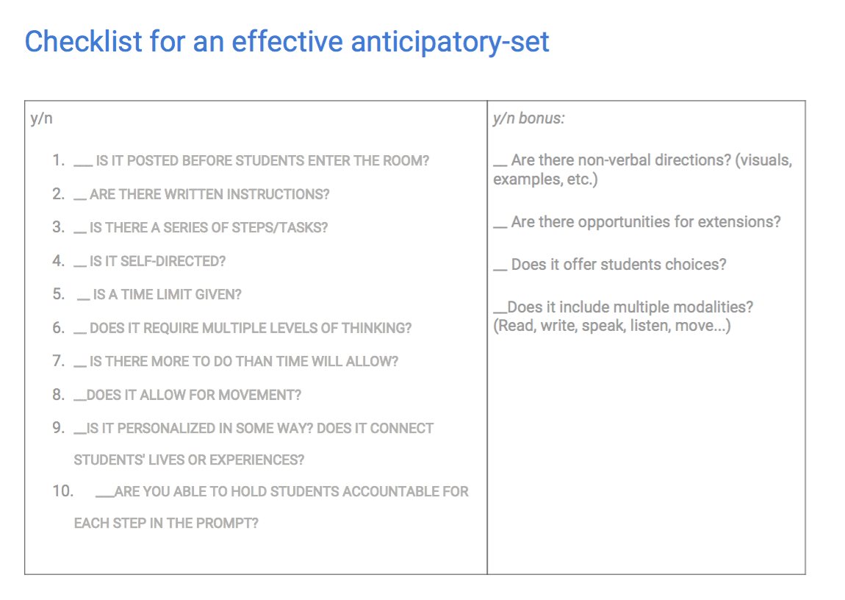
Best Practices for Creating an Effective Anti-Set or Closure

Slide 12
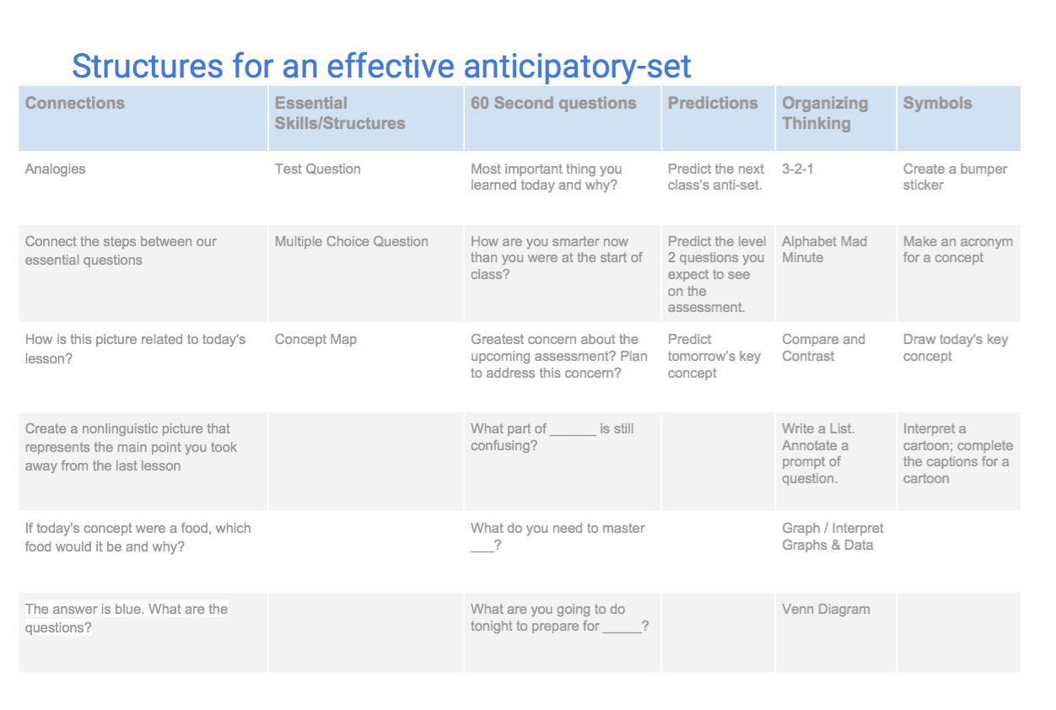
Best Practices for Structuring an Effective Anti-Set or Closure

Slide 13
Best Practice for Accessibility
OIT website with Accessibility support for Google Slides:
https://oit.colorado.edu/services/messaging-collaboration/gsuite/accessibility/slides
Best Practices for getting started:
Use predefined slide layouts
Ensure the tab reading order is the actual reading order
Add images, tables, & text boxes should have alt text [Command+Option+Y]
Consider presentation best practices when adding content to your slides
Check your work with View > HTML View
Instructions to Embed Google Slides:
in Canvas

Slide 14
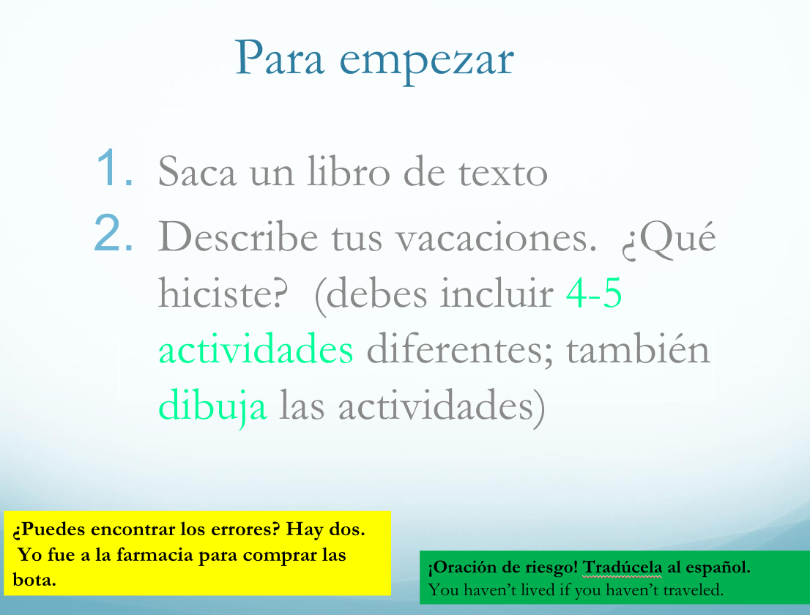
Spanish 2 Anti-Set

Slide 15
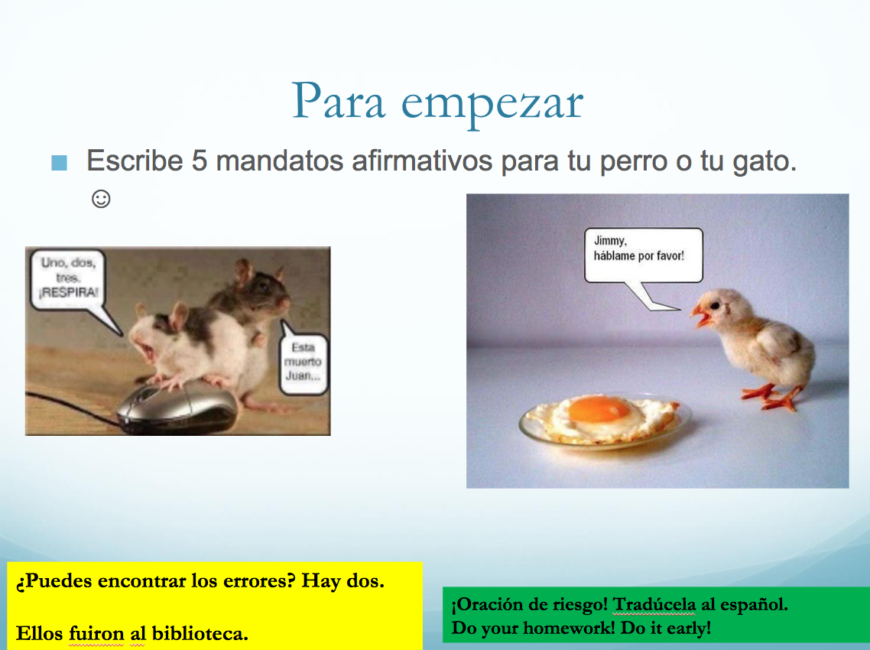
Spanish 2 Anti-Set

Slide 16
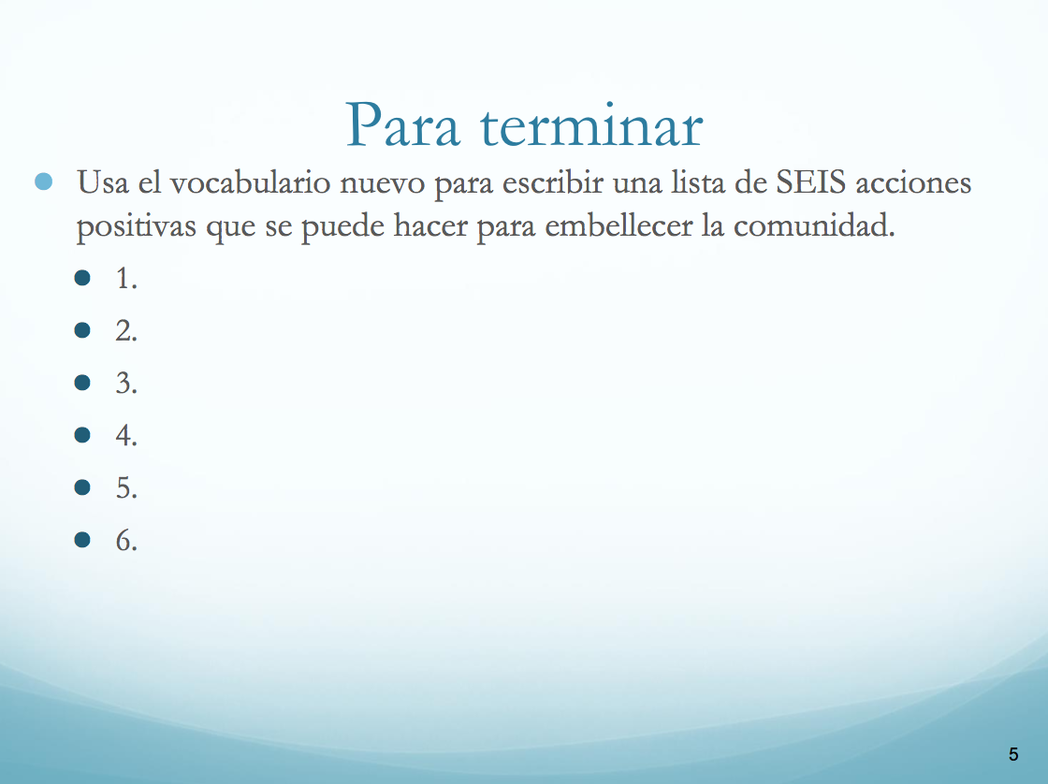
Spanish 2 Closure

Slide 17
Create Your Own
BYOC: Introduction to Teaching with Canvas
By the end of this session, participants will be able to:
Navigate Canvas
Communicate with students
Create and edit Calendar Events and Assignments.
Organize their course
Share course material
Enter grades for students
Monitor the course and students
State where they find Canvas support.
Start with the objectives.
Select an appropriate structure.
Review the checklist.
Ask for feedback from a colleague.

Slide 18
Closure
Please write down your thoughts in the handout.
How would you describe the structure of anticipatory-sets or closures to a faculty member not present today? In your own words...
Why do implementing best practices with anticipatory-sets & closures further students’ critical thinking skills?
In your own words, explain why you think I selected this topic for today.
Extension: What is the structure for this closure? ;)

Slide 19
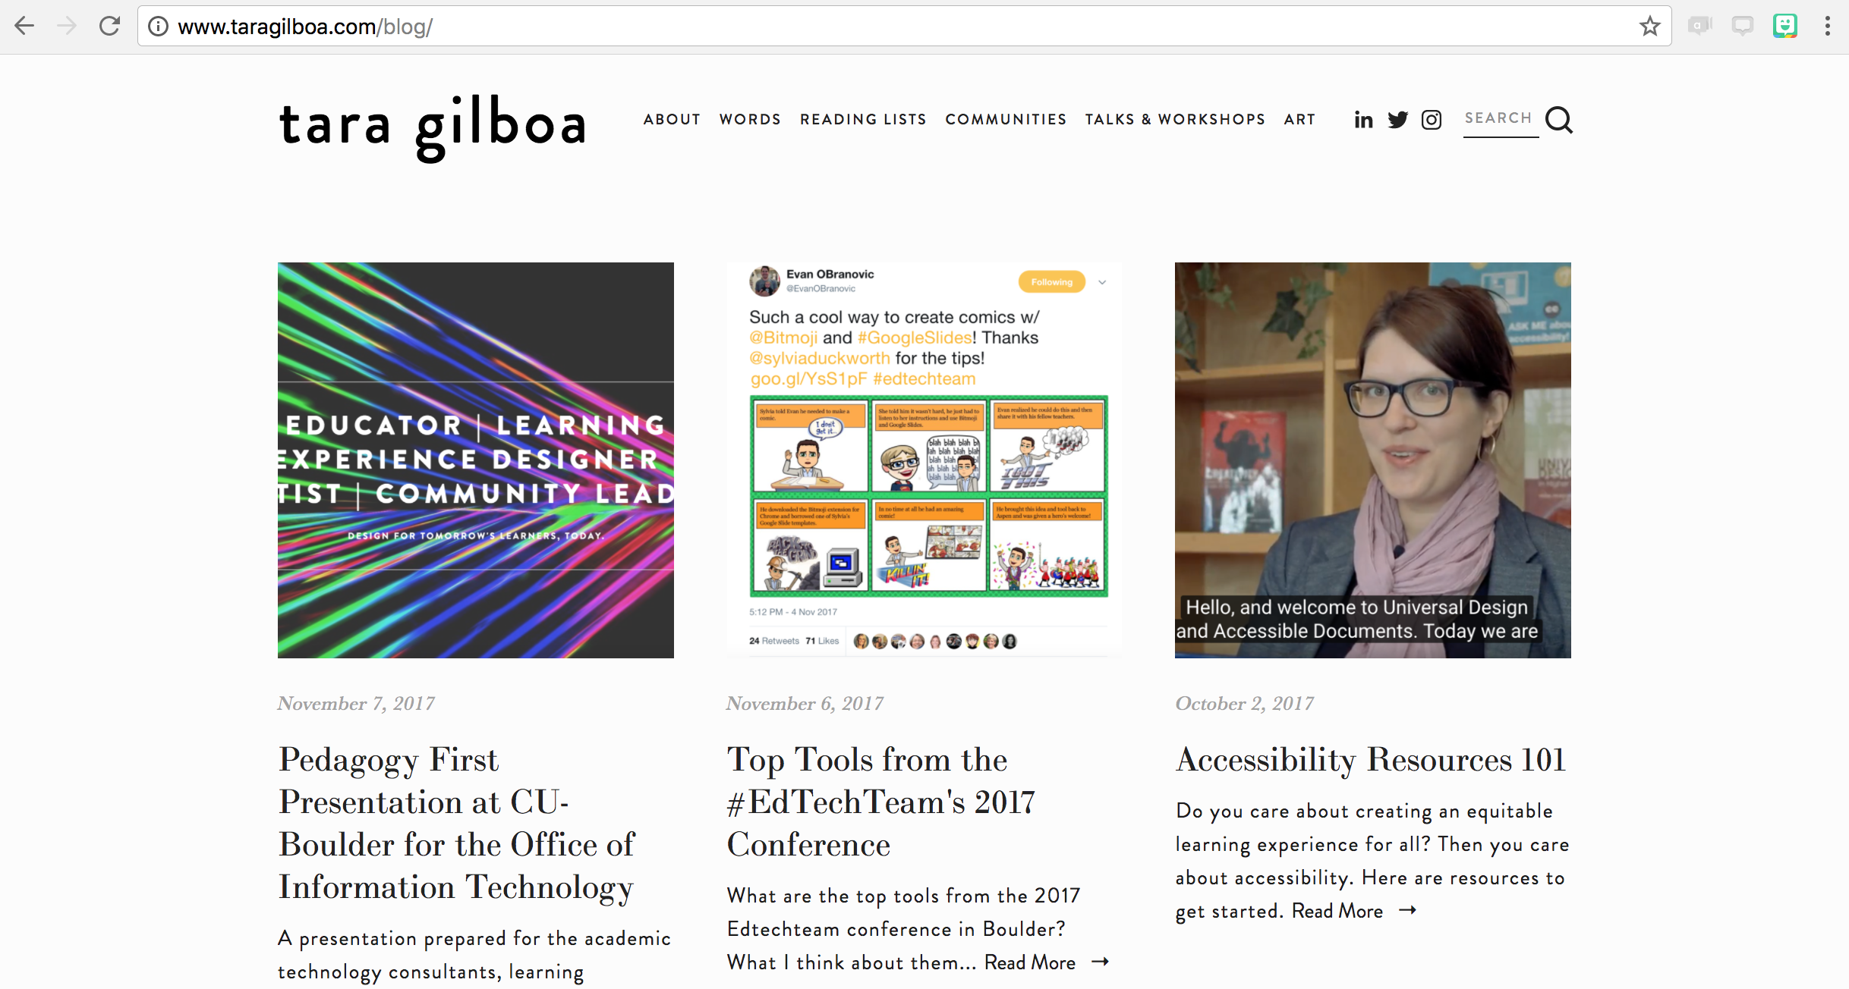
Q&A
Thank you for attending on snowy Tuesday!
Tara Gilboa
www.taragilboa.com
www.bolderlearning.design
@TiGilboa

